Slide 1

Nepal
Janani Janmabhumishcha Swargadapi Gariyasi
"Mother and Motherland are Greater Than Heaven"
Prabesh Adhikari
Birat Rai

Slide 2
General
In Asia Continent
South, Between China and India
28°10′N 84°15′E
Kathmandu as Capital City
Nepali as Official Language
Notes:
Insert a map of your country.

Slide 3
Current economic situation of nepal
Notes:
Insert a picture of one of the geographic features of your country.

Slide 4
Data
Area 147516 sq km
Population 3066598
GDP (PPP) $141.1 billion
GDP (Nominal) $39 billion
HDI 0.0602
PPP (Purchasing Power Parity)
Measurement of the price of specific goods in different countries and is used to compare the absolute purchasing power of the countries’ currencies.
Nominal
Total value of all goods and services produced in a given time period less the value of those made during the production process
Notes:
Insert a picture illustrating a season in your country.

Slide 5
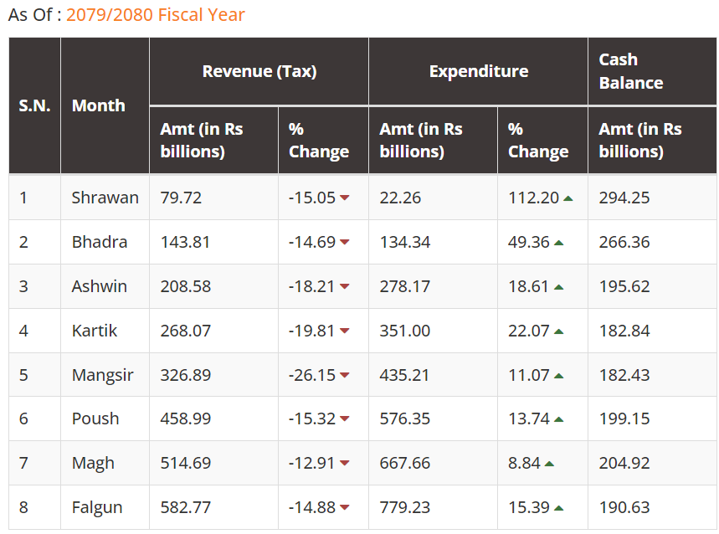
Revenue and expenditure
Source: https://www.sharesansar.com/government-revenue-expenditure
Notes:
Insert a picture of an animal and or plant found in your country.

Slide 6
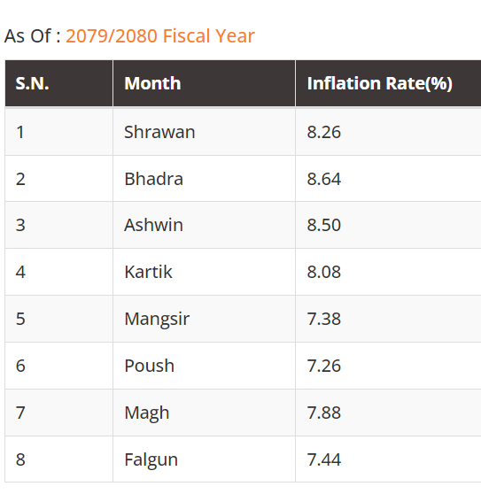
inflation
Source: https://www.sharesansar.com/inflation
Notes:
Insert a picture of an animal and or plant found in your country.

Slide 7
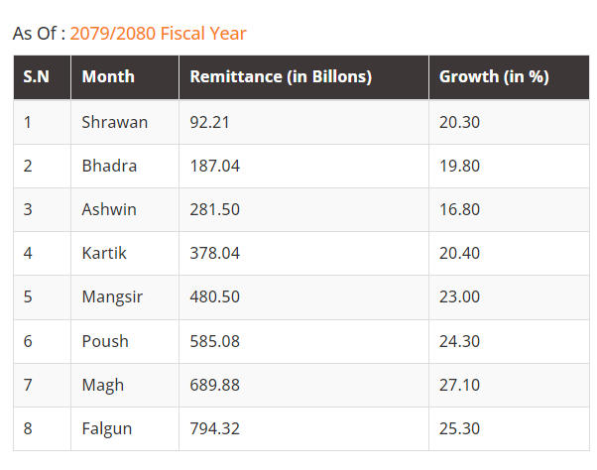
remittance
Source: https://www.sharesansar.com/remittance
Notes:
Insert a picture of an animal and or plant found in your country.

Slide 8
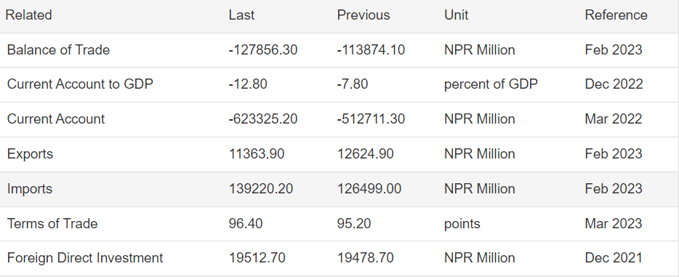
trade
Source: https://tradingeconomics.com/nepal/balance-of-trade

Slide 9
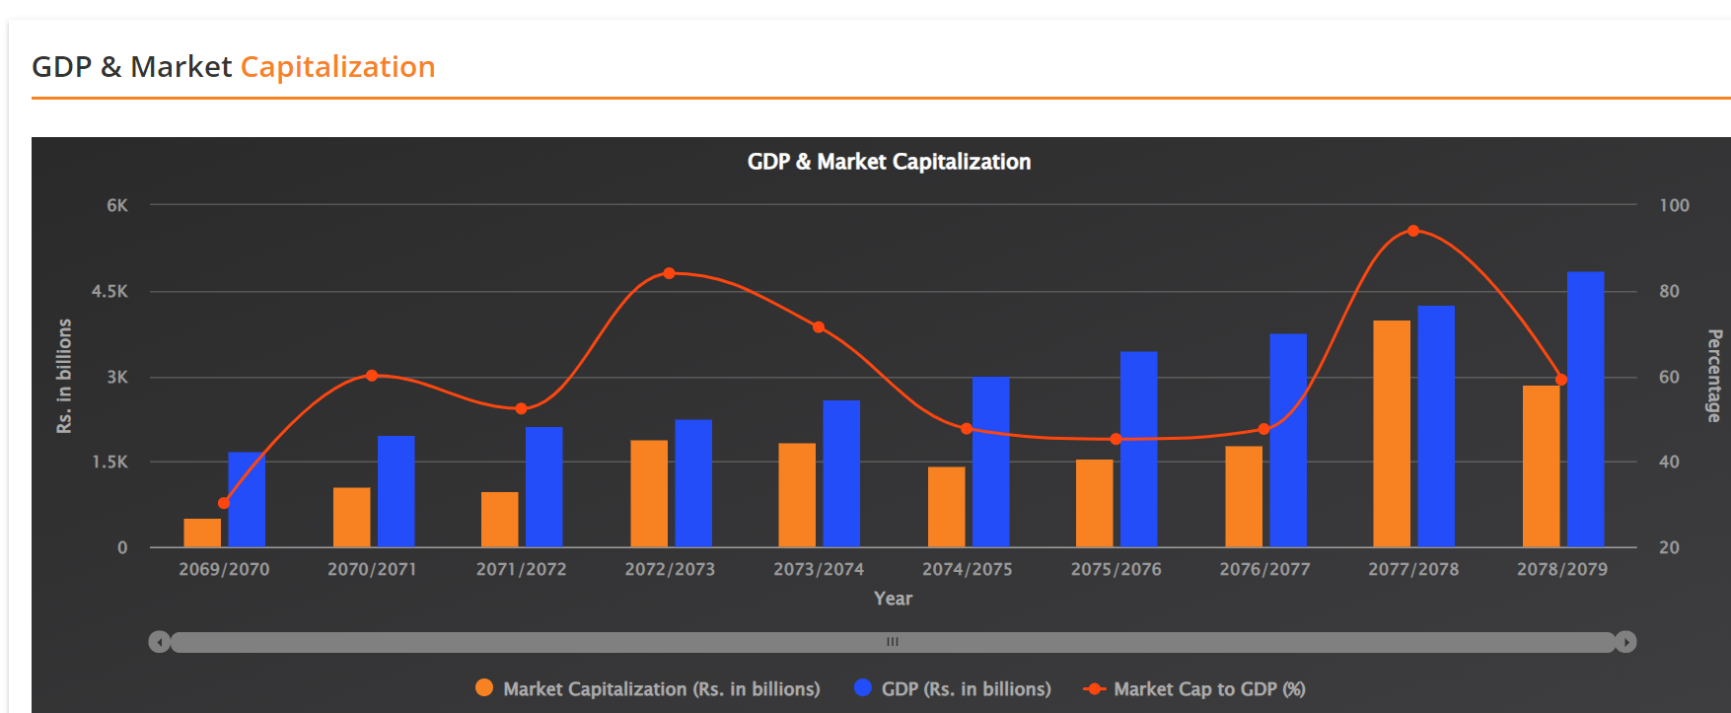
Source: https://www.sharesansar.com/gdp-market-capitalization
Notes:
Insert a picture of an animal and or plant found in your country.

Slide 10
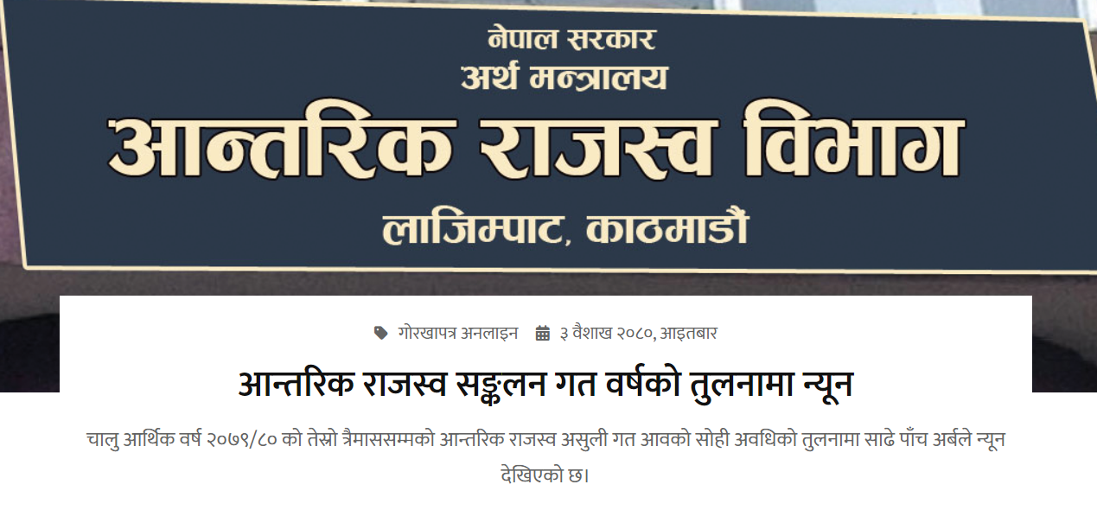
Source: https://ekantipur.com/
Notes:
Insert a picture of the head leader of your country.

Slide 11
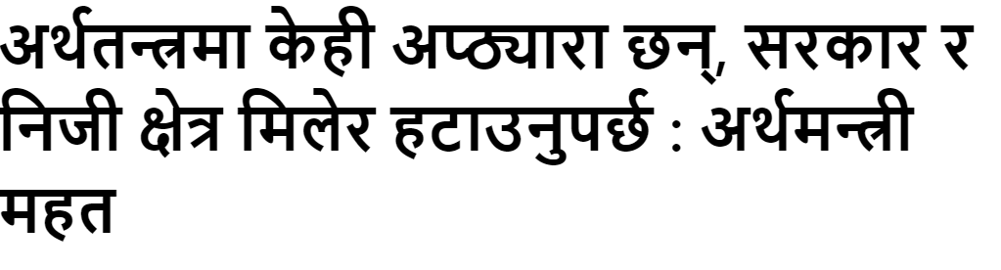
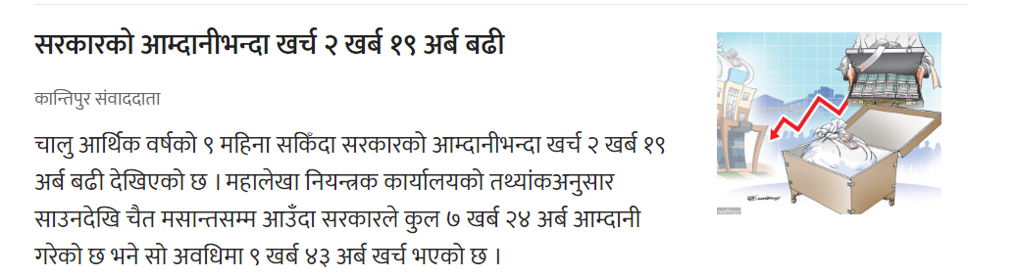

Slide 12
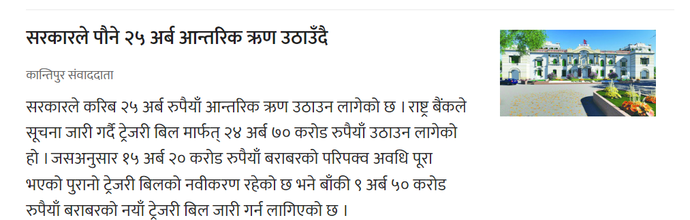

Slide 13
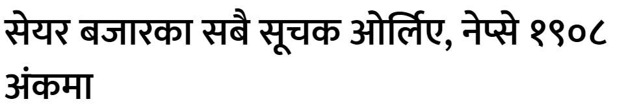
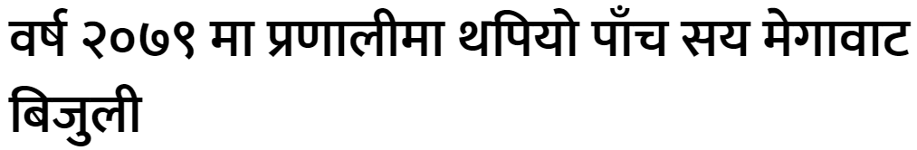
Notes:
Insert a picture that illustrates some part of your country’s economy.

Slide 14

Notes:
Insert a picture of one of the points of interest for your country.

